Slide 1
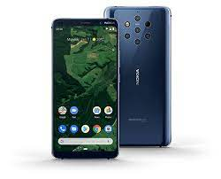

Home automation using android device

Slide 2
What is home automation
Home automation involves inTRoducing a degree of computerized or automatic control to certain electrical and elecTRaonics system in a building
These lighting,temperatURe conTRol etc.., this paper demonsTRate a simple home automation system which contains a remote mobile host controller and several client module (home appliances).
The client module communicates with host through a wireless system like Bluetooth Enebaled in mobile phone

Slide 3
ANDROID
Android has an active community of developers and enthusiasts who use the Android Open Source
Project (AOSP) source code to develop and distribute their own modified versions of the operating
System

Slide 4
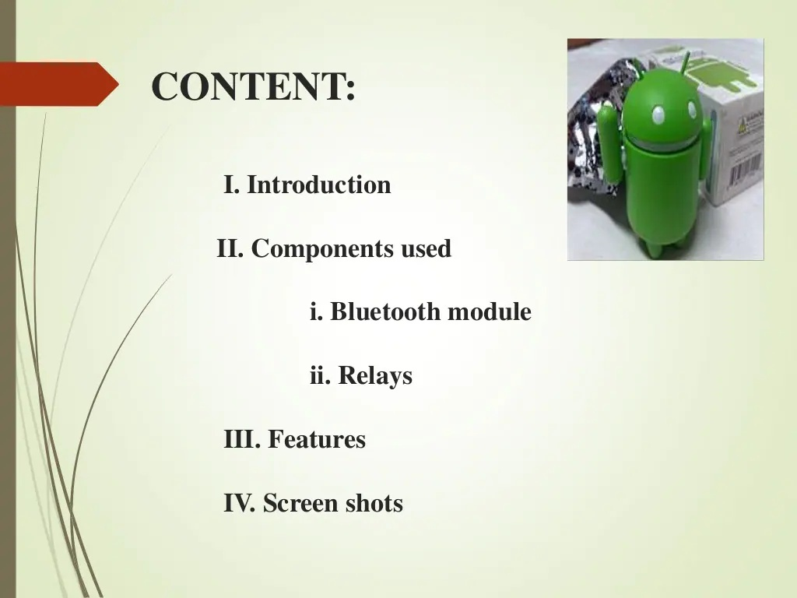

Slide 5
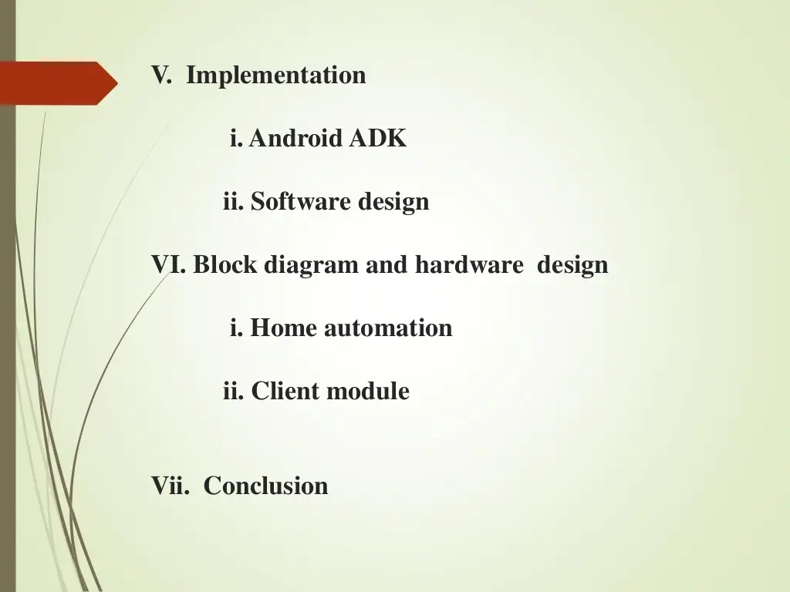

Slide 6
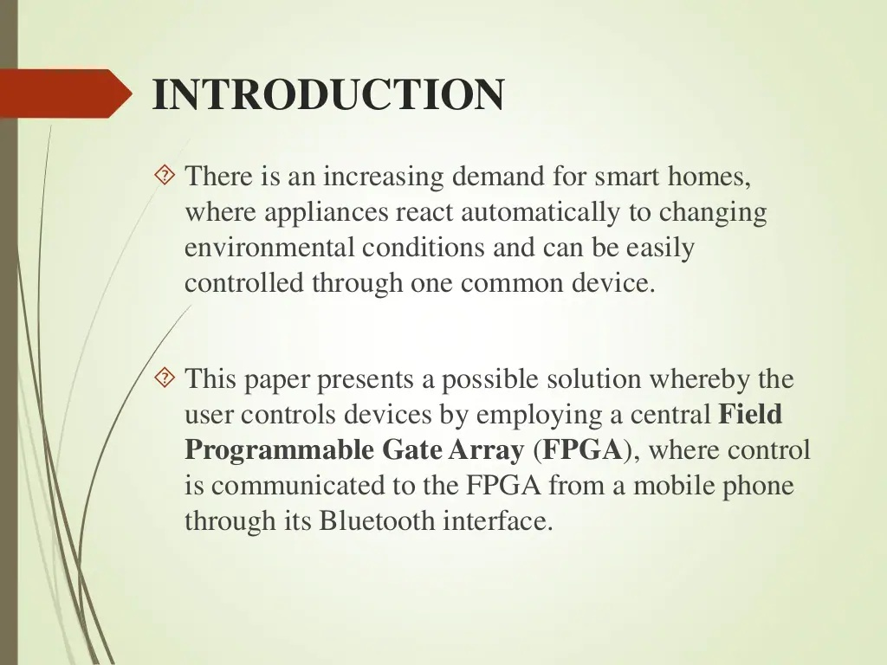

Slide 7
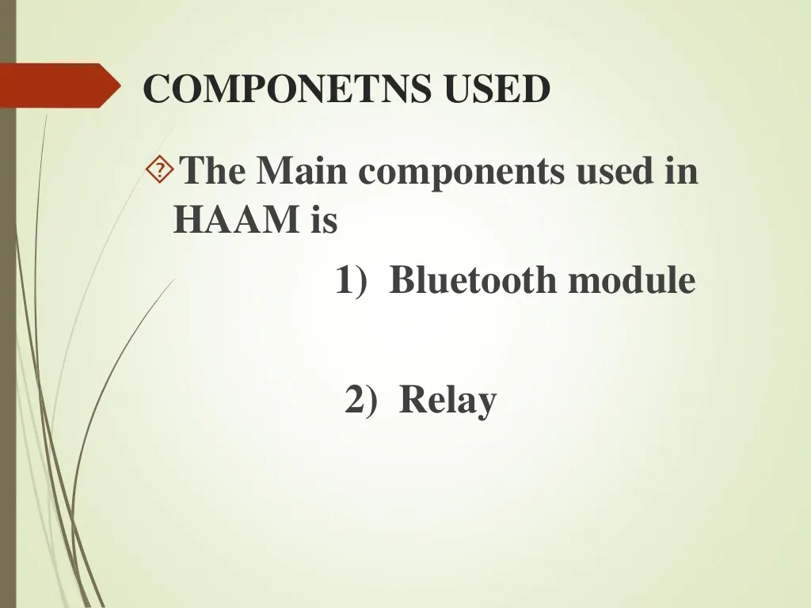

Slide 9
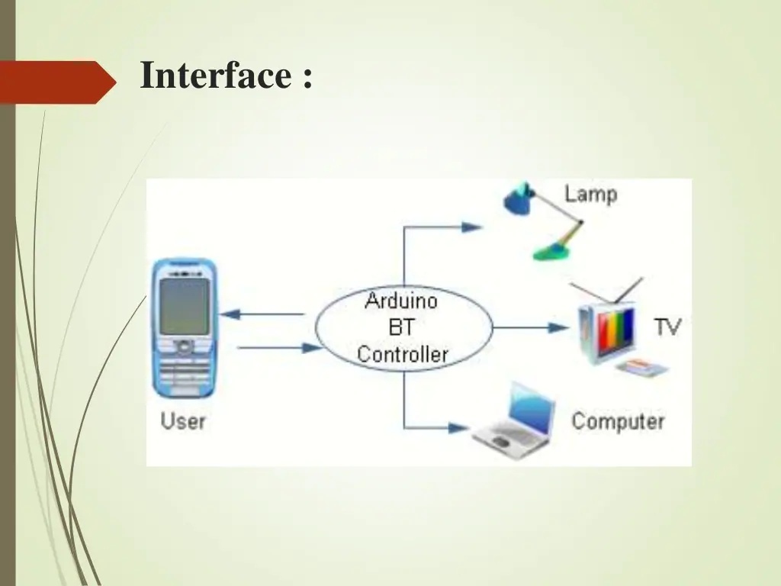

Slide 11
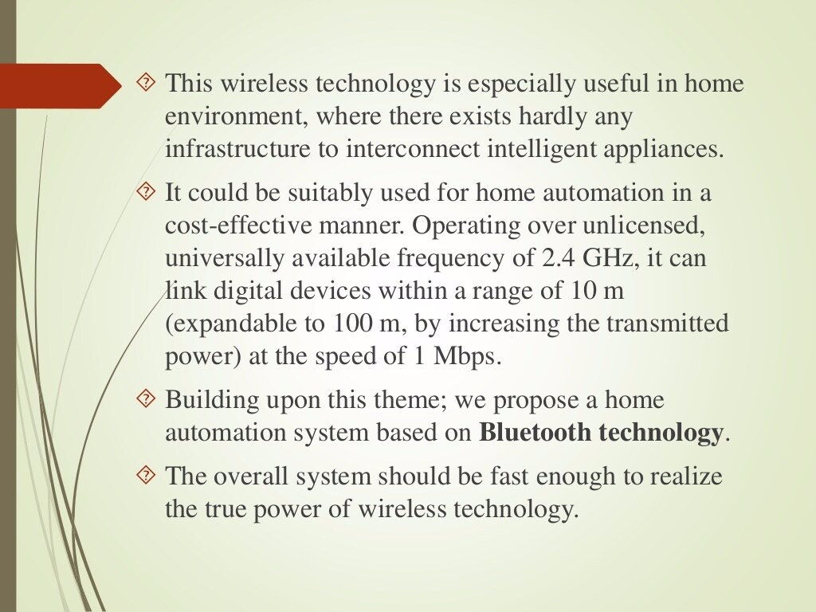

Slide 12
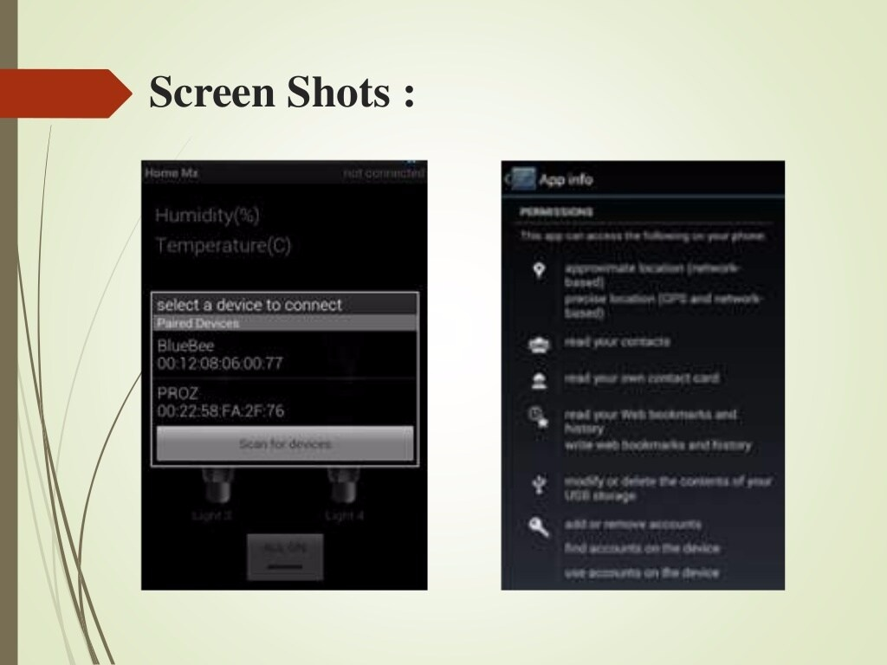

Slide 13
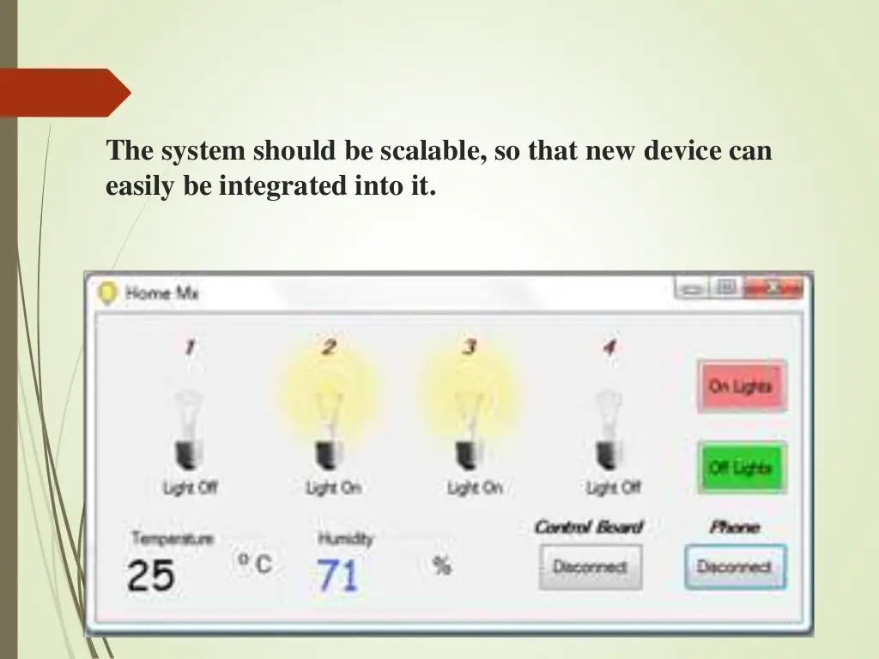

Slide 14
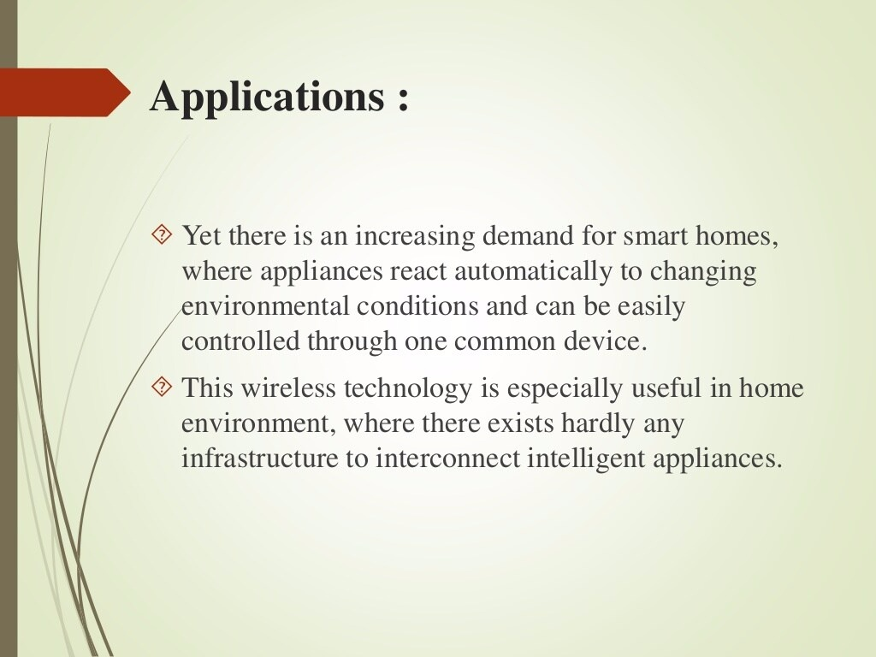

Slide 15
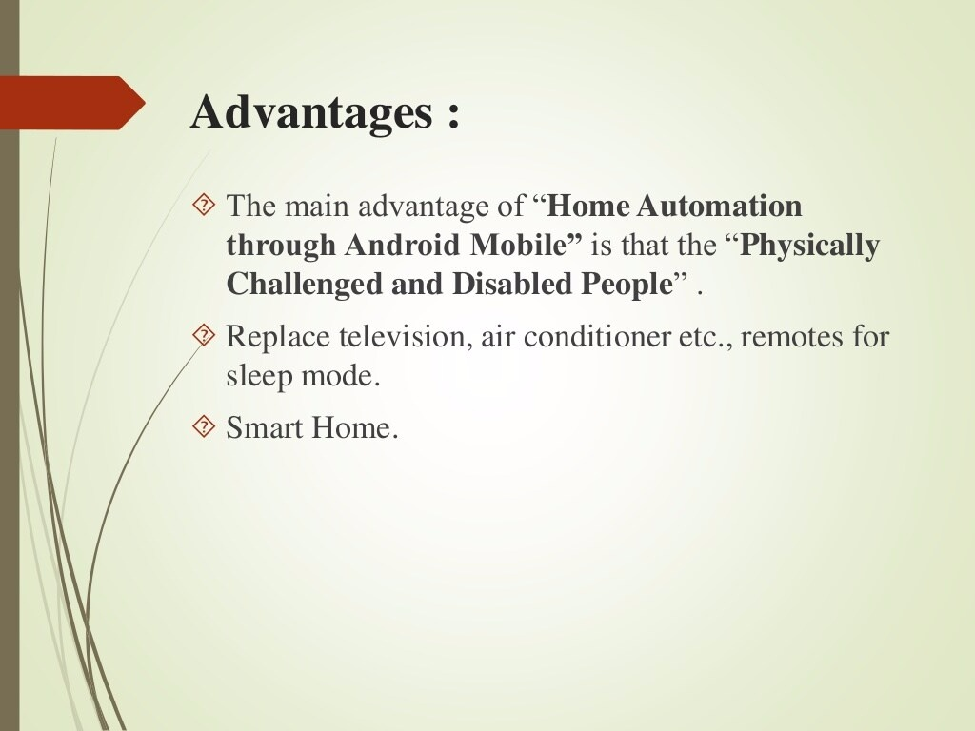

Slide 16
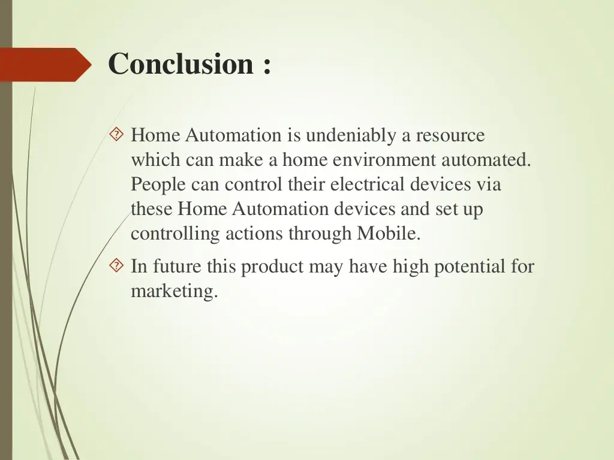

Slide 17


